Slide 1
SOFTWARE REQUIREMENTS

Slide 2
What is software requirements?
The software requirements are description of features and functionalities of the target system.
Requirements convey the expectations of users from the software product.
The requirements can be obvious or hidden, known or unknown, expected or unexpected from client’s point of view.

Slide 3
Who reads the software engineering document?
Users
Design team
Developers
Testing team

Slide 4
What is Requirements engineering?
The process of establishing the services that the customer requires from a system and the constraints under which it operates and is developed
The requirements themselves are the descriptions of the system services and constraints that are generated during the requirements engineering process
Requirements specify what the system is supposed to do, but not how the system is to accomplish its task

Slide 5
The goal of requirement engineering is to develop and maintain sophisticated and descriptive ‘System Requirements Specification’ document.
Requirement Engineering Process
It is a four step process, which includes –
1. Feasibility Study
2. Requirement Gathering
3. Software Requirement Specification
4. Software Requirement Validation

Slide 6
Types of requirements
1. User requirements
  Statements in natural language plus diagrams of the services the system provides and its operational constraints. Written for customers
2. System requirements
  A structured document setting out detailed descriptions of the system services. Written as a contract between client and contractor
3. Software specification
  A detailed software description which can serve as a basis for a design or implementation. Written for developers

Slide 7
User requirements
Should describe functional and non-functional requirements so that they are understandable by system users who don’t have detailed technical knowledge
User requirements are defined using natural language, tables, and diagrams
Problems with natural language
  Precision vs. understandability
  Functional vs. non-functional requirements confusion
  Requirements amalgamation

Slide 8
System requirements
System requirements are the configuration that a system must have in order for a hardware or software application to run smoothly and efficiently.
Failure to meet these requirements can result in installation problems or performance problems.
The former may prevent a device or application from getting installed, whereas the latter may cause a product to malfunction or perform below expectation or even to hang or crash

Slide 9
Examples of system requirements
Operating System (i.e. Windows XP, SP 2 or Mac OS X 10.3.8)
Processor Speed (i.e. Pentium 4, 3.2 GHz or Power PC G5, 2.0 GHz)
Memory, a.k.a. RAM (i.e. 512 MB)
Graphics Card (i.e. ATI Radeon 9800 w/ 256 MB video memory)
Hard Disk Space (i.e. 80 GB available)

Slide 10
Functional and non-functional requirements
Functional requirements
  Statements of services the system should provide, how the system should react to particular inputs and how the system should behave in particular situations.
Non-functional requirements
  constraints on the services or functions offered by the system such as timing constraints, constraints on the development process, standards, etc.
Domain requirements
  Domain requirements reflect the environment in which the system operates so, when we talk about an application domain we mean environments such as train operation, medical records, e-commerce etc

Slide 11
Examples of functional requirements
The user shall be able to search either all of the initial set of databases or select a subset from it.
The system shall provide appropriate viewers for the user to read documents in the document store.
The Sales system should allow users to record customers sales
Sales reports should be generated every after 24hours

Slide 12
Requirements precision, completeness, and consistency
In principle requirements should be precise, complete, and consistent
Precise
  They should state exactly what is desired of the system
Complete
  They should include descriptions of all facilities required
Consistent
  There should be no conflicts or contradictions in the descriptions of the system facilities
In practice, it is very difficult to produce a complete and consistent requirements document

Slide 13
Non-functional requirements
Define system properties and constraints e.g. reliability, response time and storage requirements. Constraints are I/O device capability, system representations, etc.
Non-functional requirements describe how the system works,
Non-functional requirements may be more critical than functional requirements. If these are not met, the system is useless

Slide 14
Non-functional classifications
Product requirements
  Requirements which specify that the delivered product must behave in a particular way e.g. execution speed, reliability, etc.
Organisational requirements
  Requirements which are a consequence of organisational policies and procedures e.g. process standards used, implementation requirements, etc.
External requirements
  Requirements which arise from factors which are external to the system and its development process e.g. interoperability requirements, legislative requirements, etc.

Slide 15
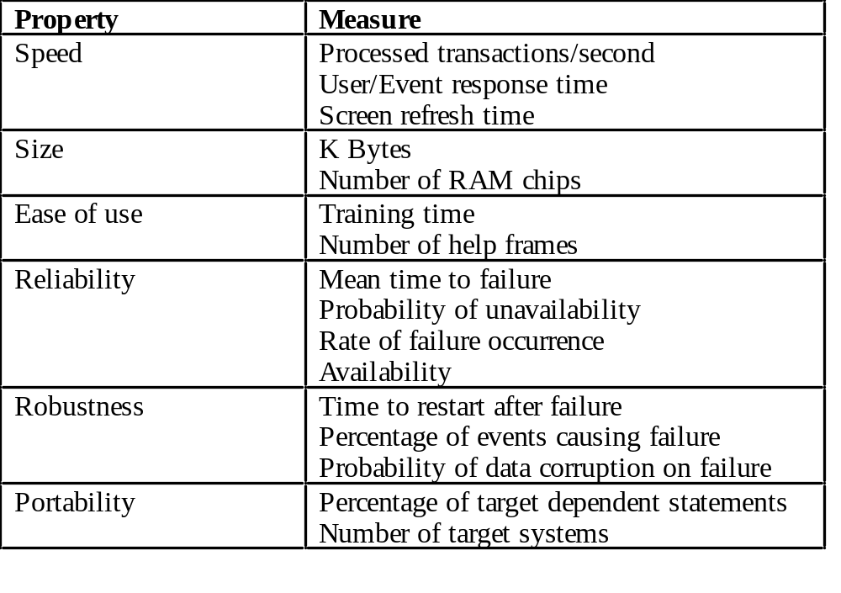
Non-functional requirements measures

Slide 16
Requirements interaction
Conflicts between different non-functional requirements are common in complex systems
Spacecraft system
  To minimise weight, the number of separate chips in the system should be minimised
  To minimise power consumption, lower power chips should be used
  But, using low power chips may mean that more chips have to be used
  Which is the most critical requirement?

Slide 17
Requirements document
Specify external system behaviour
Specify implementation constraints
Easy to change
Serve as reference tool for maintenance
Record forethought about the life cycle of the system
  i.e. predict changes
Characterise responses to unexpected events

Slide 18
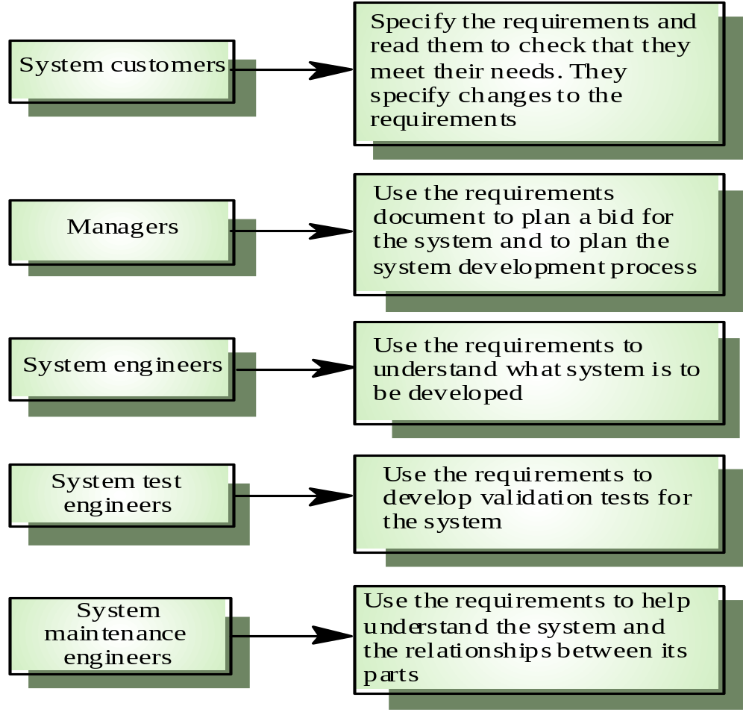
Users of a requirements document

Slide 19
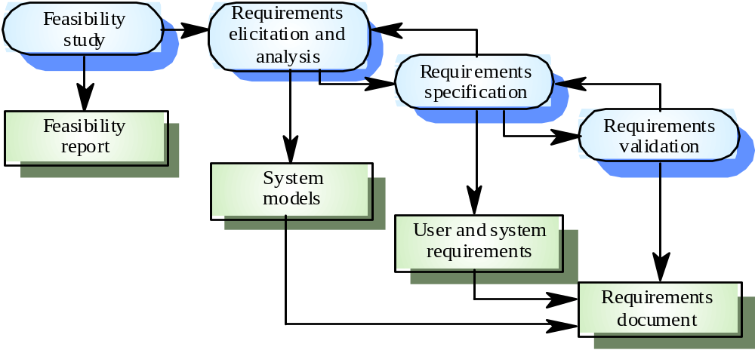
Requirements engineering process

Slide 20
Feasibility studies
A feasibility study decides whether or not the proposed system is worthwhile
A short focused study that checks
  If the system contributes to organisational objectives
  If the system can be engineered using current technology and within budget
  If the system can be integrated with other systems that are used

Slide 21
Elicitation and analysis
Sometimes called requirements elicitation or requirements discovery
Involves technical staff working with customers to find out about
  the application domain
  the services that the system should provide
  the system’s operational constraints
May involve end-users, managers, engineers involved in maintenance, domain experts, trade unions, etc.
  These are called stakeholders

Slide 22
Problems of requirements analysis
Stakeholders don’t know what they really want
Stakeholders express requirements in their own terms
Different stakeholders may have conflicting requirements
Organisational and political factors may influence the system requirements
The requirements change during the analysis process
  New stakeholders may emerge and the business environment change

Slide 23
System models
Different models may be produced during the requirements analysis activity
Requirements analysis may involve three structuring activities which result in these different models
  Partitioning – Identifies the structural (part-of) relationships between entities
  Abstraction – Identifies generalities among entities
  Projection – Identifies different ways of looking at a problem
System models will be covered on January 30

Slide 24
Scenarios
Scenarios are descriptions of how a system is used in practice
They are helpful in requirements elicitation as people can relate to these more readily than abstract statement of what they require from a system
Scenarios are particularly useful for adding detail to an outline requirements description

Slide 25
Requirements validation
Concerned with demonstrating that the requirements define the system that the customer really wants
Requirements error costs are high so validation is very important
  Fixing a requirements error after delivery may cost up to 100 times the cost of fixing an implementation error
Requirements checking
  Validity
  Consistency
  Completeness
  Realism
  Verifiability

Slide 26
Requirements validation techniques
Reviews
  Systematic manual analysis of the requirements
Prototyping
  Using an executable model of the system to check requirements.
Test-case generation
  Developing tests for requirements to check testability
Automated consistency analysis
  Checking the consistency of a structured requirements description

